Slide 1
Understanding the factors that influence the popularity of mobile applications
A comparative study between Android apps and IOS apps
DATS 6103 - Individual Project 2 - Poornima Joshi
27th November 2018

Slide 2
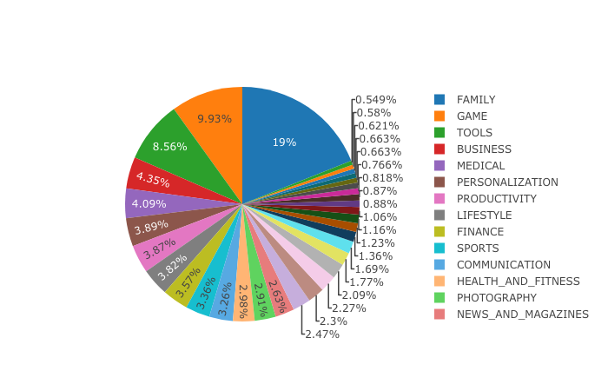
EDA
Android’s Play Store

Slide 3
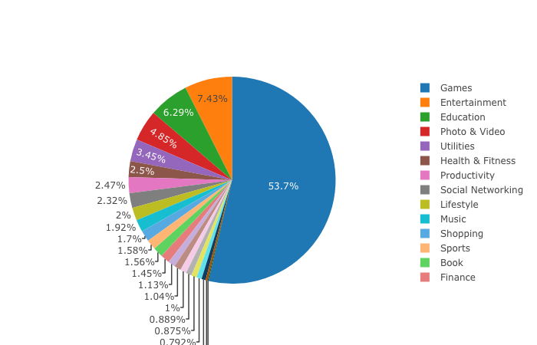
EDA
Apple’s App Store

Slide 4
Does popularity correlate with the characteristics of an app like number of installations and number of ratings?
Yes, there is positive correlation between number of installations or number of ratings and the popularity.
Higher the rating, it is more likely the user installs.

Slide 5
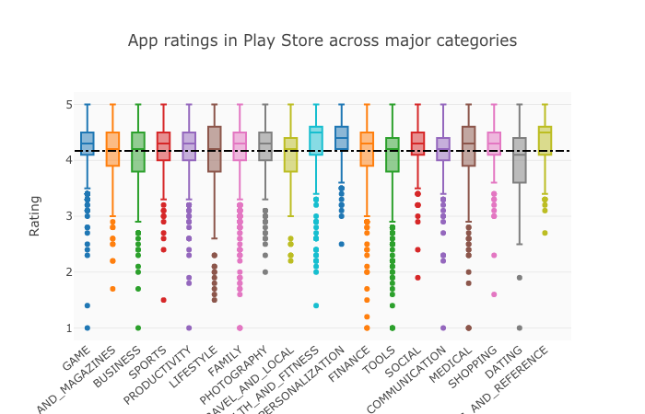
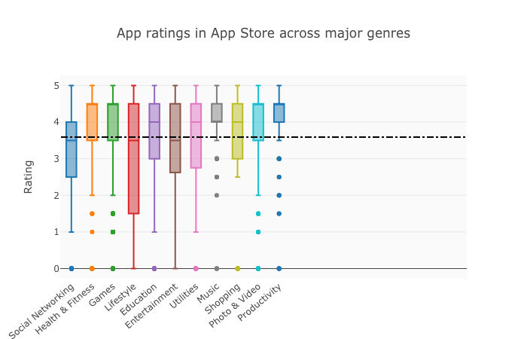
How does popularity vary per genre?
Most app categories in Play store are performing reasonably well with medians lying around the overall average.
Most app genres in App store are performing reasonably ok with medians lying around the overall average, however not as well as android apps when comparing with the averages.

Slide 6
How does popularity vary by application size?
In android apps, there is no correlation between size of an app and rating. However, in IOS apps, the larger the apps are, higher ratings are observed.

Slide 7
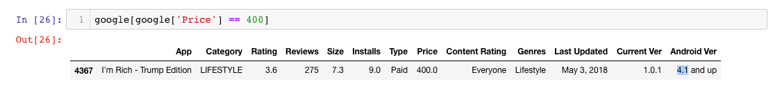
How does popularity vary with price?
Interestingly, between $0 - $20, there is a positive correlation between price and rating. It indicates that users are willing to pay a price for high quality apps.
I’m Rich - Trump Edition is the highest priced app with $400 in Google Play store and LAMP Words For Life is priced at $300 - highest in Apple’s App store.

Slide 8
What is the impact that new versions have on popularity of an application?
On an overview in the Play Store, there seemed to be sight positive correlation with Version and Rating. However, significant amount of apps have versions between 0 and 20. On drilling down and focusing on these subset of apps between 0 and 20, there is nearly no correlation between releasing versions and being more popular in Play Store.
There is positive correlation between user rating and releasing versions. It indicates that in App store, versions are significantly improving products.

Slide 9
In conclusion :
Ratings affect installations
Health & fitness and Education/ Books are generally high rated. Dating apps have low average rating in both Android and IOS apps.
No correlation between size of an app and rating.
Positive correlation between price and rating.
New versions have no significant impact on rating.

Slide 10
Future Work:
Compare the independent variables with each other to see if any of them correlate with themselves.
Learning outcome:
Working with different kinds of large datasets and comparing them.
Cleaning data takes a significant amount of time.

